Slide 1
Starter Task
In what ways can a website be interactive?
  Discuss and feedback ideas.

Slide 2

JavaScript
Tutorial One: Getting Started

Slide 3
Aims and Objectives:
Aim:
  Students will be introduced to JavaScript
Objectives:
  Students will apply methods to the DOM
  Students will use maths expressions
  Students will use conditional branching
  Students will use functions
  Students will create a simple JavaScript app

Slide 4
JavaScript
JavaScript is the programming language of HTML and the Web.
You can code in straight ahead JS or use the many libraries including:
  Angular
  Node
  React
  Express
  AFrame
  Etc.

Slide 5
How it works…
HTML defines the structure and content of HTML documents
CSS controls layout and design
JavaScript adds functionality to a web page

Slide 6
JS and DOM
DOM = Document Object Model
The DOM can be accessed by JS when you create a script–whether it's inline in a <script> element or included in the web page by means of a script loading instruction
You can immediately begin using the API for the document or window elements to manipulate the document itself or to get at the children of that document, which are the various elements in the web page.

Slide 7
Document Object Model Tree
Document
Root Element:
HTML
Element:
<head>
Element:
Body
Element:
<title>
Attribute:
“href”
Element:
<a>
Element:
<h1>
Text:
“My Title”
Text:
“My Link”
Text:
“My Heading”

Slide 8
JS and DOM
With the object model, JavaScript gets all the power it needs to create dynamic HTML:
  JavaScript can change all the HTML elements in the page
  JavaScript can change all the HTML attributes in the page
  JavaScript can change all the CSS styles in the page
  JavaScript can remove existing HTML elements and attributes
  JavaScript can add new HTML elements and attributes
  JavaScript can react to all existing HTML events in the page
  JavaScript can create new HTML events in the page

Slide 9
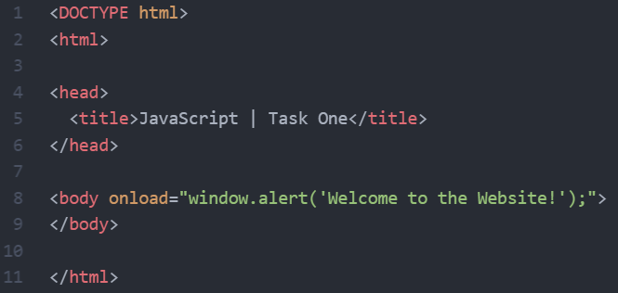
JS and DOM Example
Your DOM programming may be something as simple as the following, which displays an alert message by using the alert() function from the window object:

Slide 10
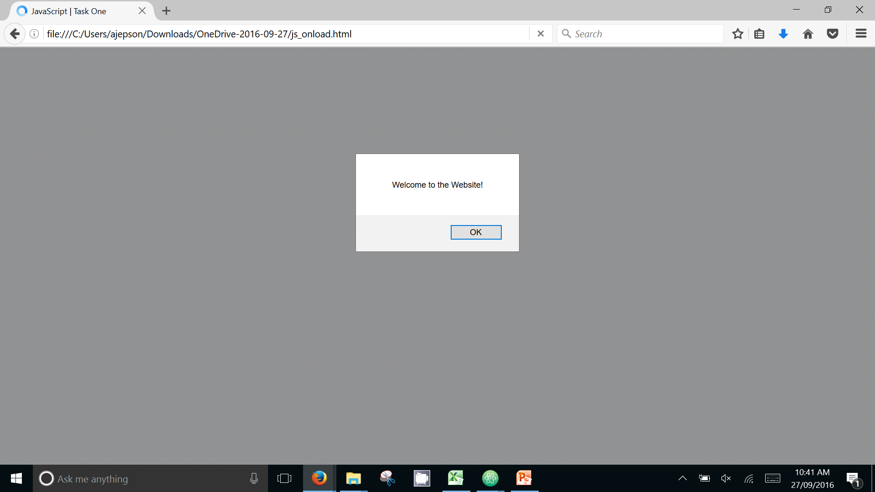
JS and DOM Example

Slide 11
JS and DOM
The next example is a bit more involved.
Aside from the <script> element in which the JavaScript is defined, this JavaScript sets a function to run when the document is loaded (and when the whole DOM is available for use).
This function creates a new H1 element, adds text to that element, and then adds the H1 to the tree for this document:

Slide 12
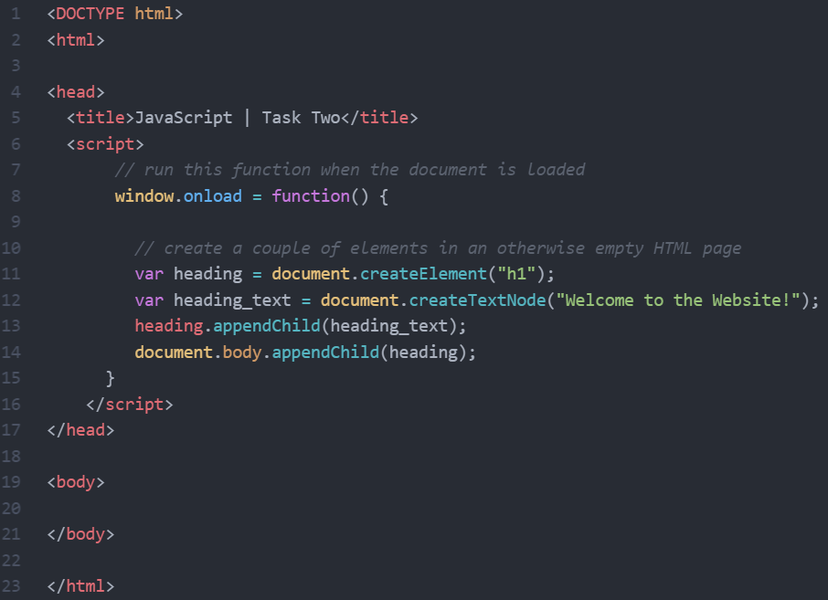
JS and DOM Example

Slide 13
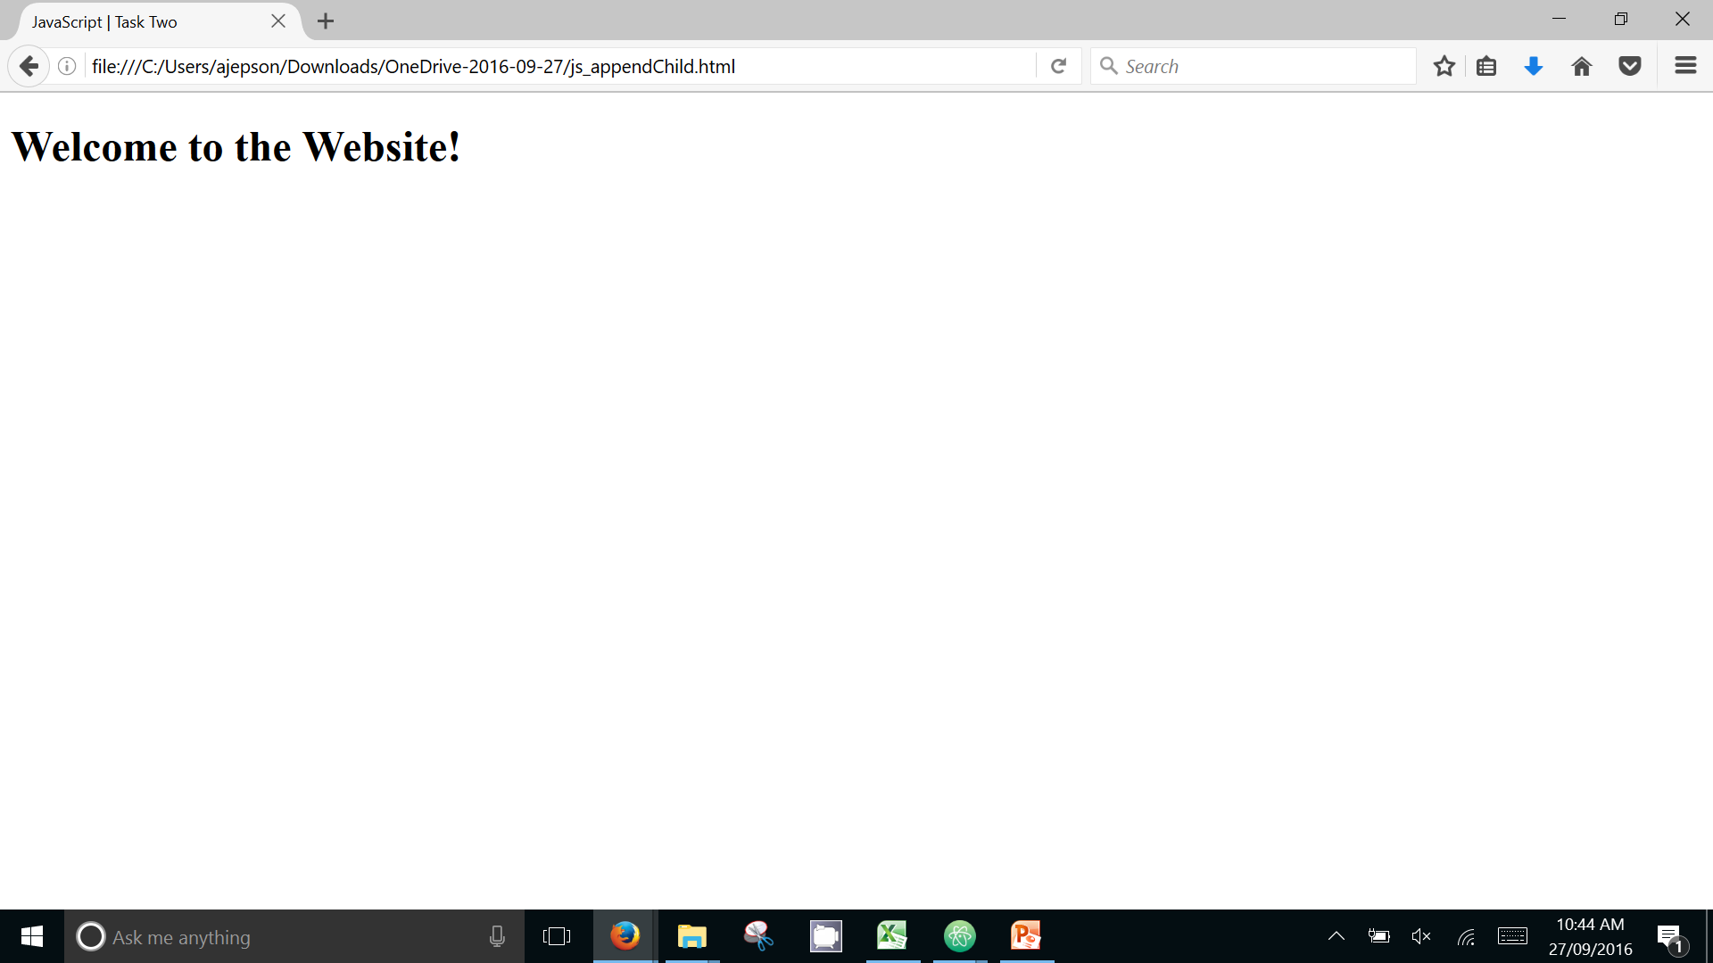
JS and DOM Example

Slide 14
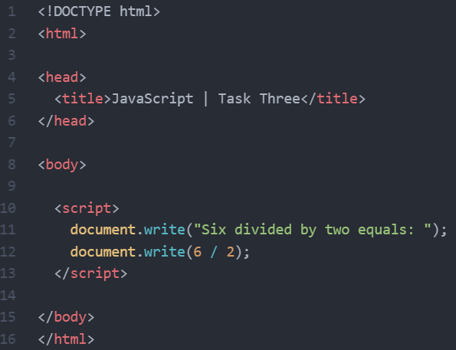
JS, DOM and Maths
This is a more straight forward example.
We are using Document and the write() method.
We are including a maths operator “/” which can be changed to +, - or *.
You will notice we are writing in a string and a simple maths sum.
The result of the sum will be written into the web page.

Slide 15
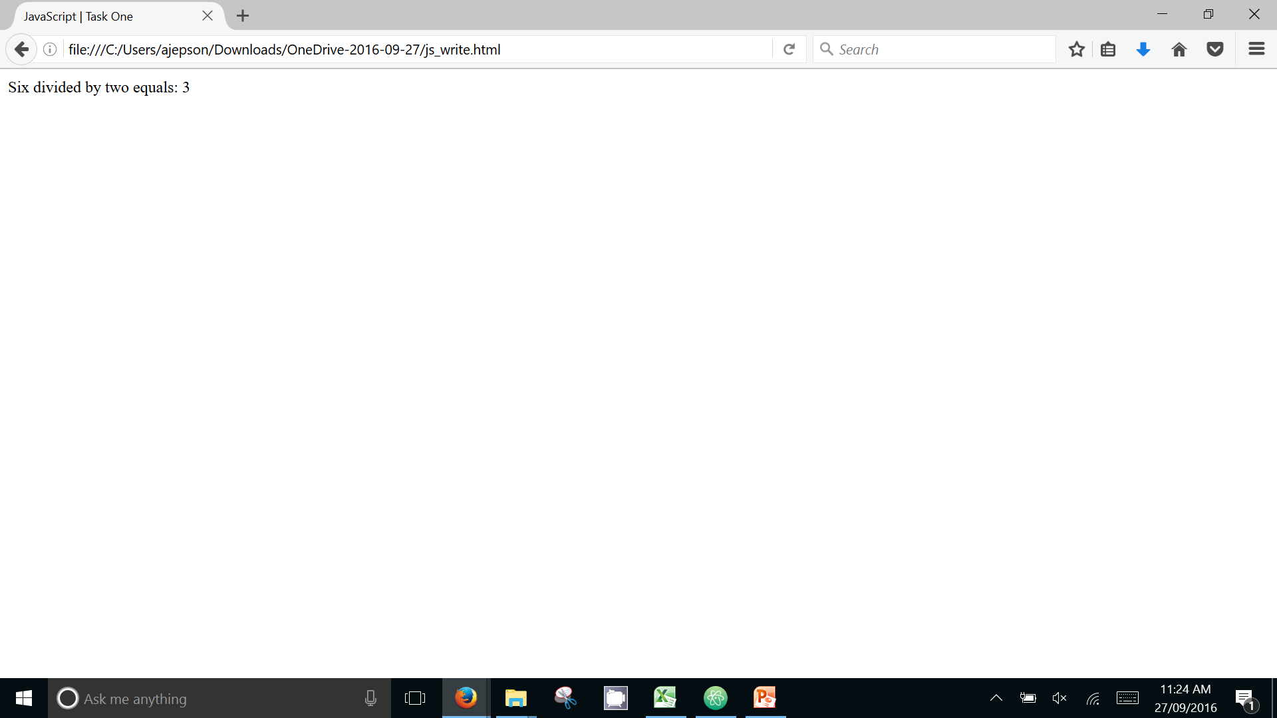
JS, DOM and Maths

Slide 16
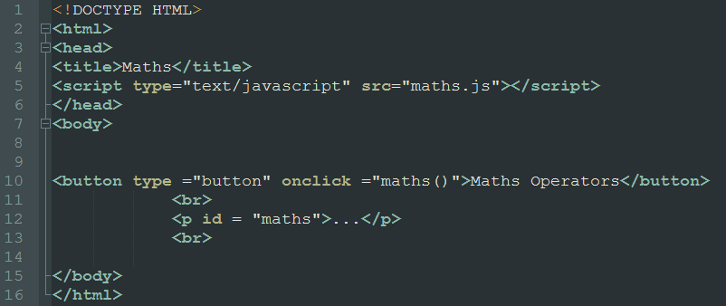
Conditions – IF Statements

Slide 17
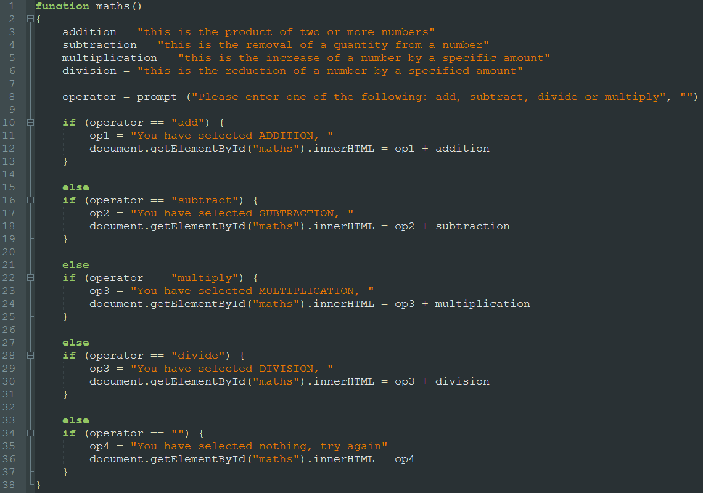
Conditions – IF Statements

Slide 18
Tasks:
Download JavaScript Workbook
Complete the tasks
Attempt the extension tasks

Slide 19
Summary:
Aim:
  Students will be introduced to JavaScript
Objectives:
  Students will apply methods to the DOM
  Students will use maths expressions
  Students will use conditional branching
  Students will use functions
  Students will create a simple JavaScript app

Slide 20
Plenary
What is a method?
What is an if statement?
What is a function?
Why might you use an external JS file?

